Slide 1
Face recognition attendance system
Project Members:
Muhammad Huzzifa Hafeez (2020-CS-606)
Hafiz Abdul Rehman (2020-CS-624)
Sadaf Imtiaz (2020-CS-628)

Slide 2
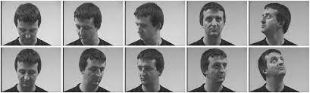
Introduction
Face Recognition is a biometric method of identifying an individual by comparing live capture or digital image data with the stored record for that person.
Face Recognition Attendance System is marking of attendance based on this technology.

Slide 3
Features:
Real time face detection
Logging Security System (Username Password)
Home Page
Student management system (Save, Take Photo Samples, Update, Delete, Clear)
Train Photo Samples
Take Attendance with Face Detection
Attendance Report (Excel file MySQL database)
Help Desk(Chatbot)
Exit System

Slide 4
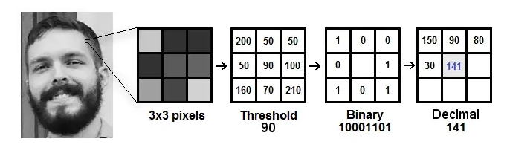
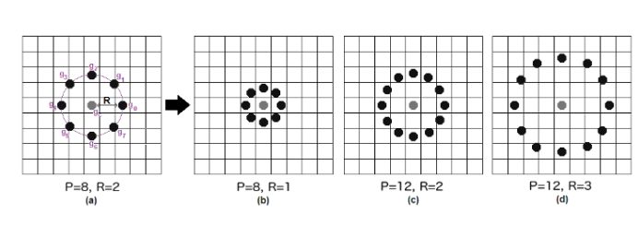
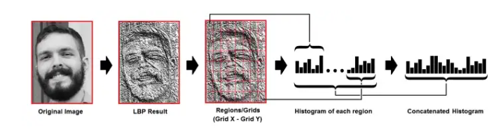

Algorithm:
LBPH algorithm(Local Binary Pattern Histogram)

Slide 5
Tools:
VS code
Sql
Techniques:
Python

Slide 6
Application and uses:
Health care
Retail
Education
Banking and finance
Automobile security
Access control
Immigration

